Slide 1

Week 3 Lab Assignment #2
By: Logan Martin

Slide 2
3 Potential problems in this data set:
Omission of race, gender, ethnicity
Name is a feature that doesn’t add value to the research
Missing values under Marital Status feature
Notes:
There were three notable issues within my data set for predicting risk of depression. These omission of potential important data features included race, gender, and ethnicity, which could make the model bias. Depression can manifest for a variety of reasons. The potential for bias in a model is exacerbated when not considering all groups of people (to race, gender, and ethnicity). For example, different races, genders, and ethnicities may experience different health and societal concerns.
Additionally, in my model, the names provided in my raw data could cloud the goal of the project. Machine Learning is looking for values in all the data. However, names are nominal data and do not add any value to the research. For example, if we had multiple Christina’s in the dataset, this would not be an actual predictor of depression, rendering this feature useless.
Missing values need to be filled in to make the model as accurate as possible. Missing values can warp the accuracy of the model and lead to bias. Therefore, it is imperative to ensure the blanks are filled in to have a cleaned-up data set that accurately depicts the data, ensuring best practices for predictions.

Slide 3
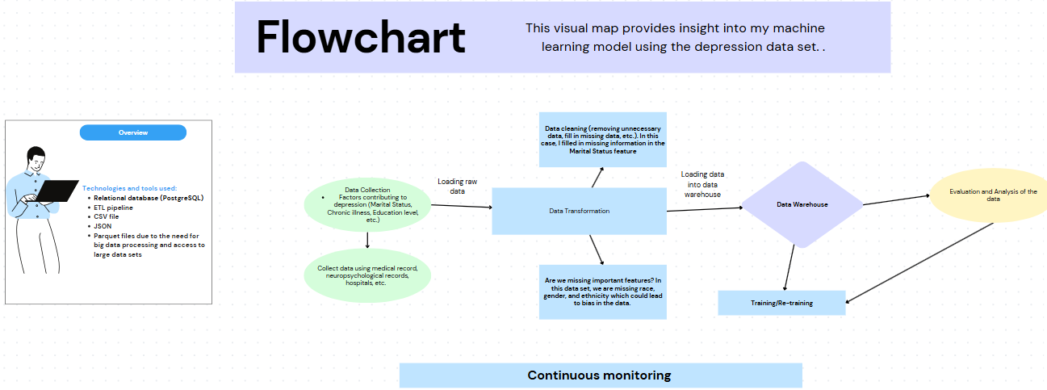
Notes:
In the flowchart shown above, I’ve created a plan for my machine learning model.
I chose to use PostgreSQL (relational database) because my data is structured and clean. It also is easy to use in an ETL pipeline structure. I want to use it as the central archive for my data. It seems like it makes it easy to extract and upload data as needed. I will use pgAdmin as my tool within my PostgreSQL database.
I chose to use an ETL pipeline because I like the structure and simplicity. It makes the process easy to keep track of. Collect the data from files, api’s, or databases, clean/ transform the data, then load it into the data warehouse.
I chose to use both CSV and JSON files. I like the idea of using CSV files because they’re easy to use for input and output functions. Additionally, using PostgreSQL, I can save my data to a CSV file from my database for future project, or whenever I want to play with the data again. When it comes to using JSON files, they coincide easily with structured data. They can also be used for extracting data, or as a destination file. I think the idea of flexibility of using these files for multiple points in my machine learning model.

Slide 4
Tools and database used:
Relational database (PostgreSQL)
ETL pipeline
CSV file
JSON
Parquet files due to the need for big data processing and access to large data sets
Notes:
For my model, structured data is a necessity, hence using a relational database. In my model, I chose to use an ETL pipeline because I’d like to clean and manipulate the data prior to training my model. Doing this all at once seems hectic. Also, in this case, near-real time data isn’t a necessity. I chose to use parquet files due to the need for big data processing and access to large data sets.

Slide 5
Plan for Schema changes overtime:
As my model develops and gathers new information, it’s important for consistent monitoring and validation to happen
By monitoring the data, we can add new information as needed and fix any bias along the way that affects the accuracy as the data changes
Using Validation technique, we can spot features with missing values and potentially combine features to help with model accuracy
Notes:
Monitoring schema changes over time in machine learning is vital for ensuring that models remain accurate and reliable. As data evolves, changes in the structure, format, or relationships of features can lead to mismatches between the model’s predictions based on new data leading to bias. By keeping track of these changes, we can quickly detect potential for bias, adjust models when needed, and maintain consistency in the data for retraining. This ongoing monitoring helps prevent potential issues and ensures that the model continues to perform accurately over time.
My plan to monitor schema changes effectively in my model is to develop a strategy for retraining models when schema changes are significant, utilize validation to ensure that incoming data matches the expected structure, and perform consistency checks between the data. This helps identify potential issues early and ensures the model remains reliable.

Slide 6
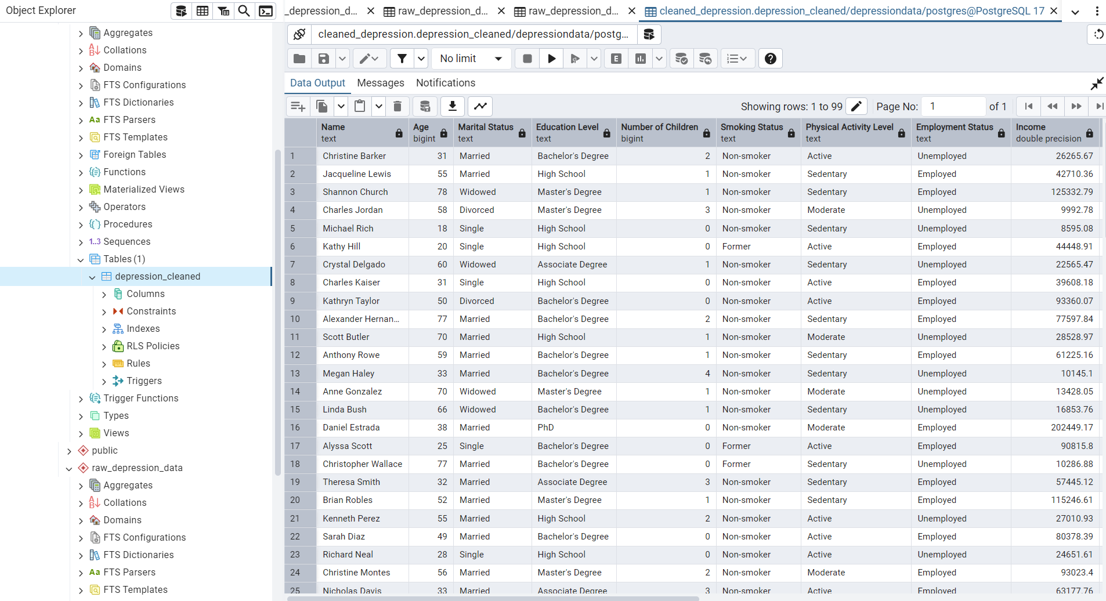
Notes:
The above image is a screenshot of my new cleaned data uploaded using pgAdmin.
For my data set I utilized a random sampling of 100 people within the data set by selecting the top 100 listed to make my data set more manageable for my learning process. After identifying my potential problems in the data set I replaced missing values. Moving forward with this data set, I will take the necessary steps to clean the data set fully. I plan to drop the name feature and consider implementing new features in attempt to make my model as accurate as possible and mitigate bias.

